Slide 1
Teleoperation System Design of Valve Turning Motions in Degraded Communication Conditions
Stéphane Caron Yoshihiko Nakamura
Nakamura-Takano Laboratory,
The University of Tokyo

Slide 2
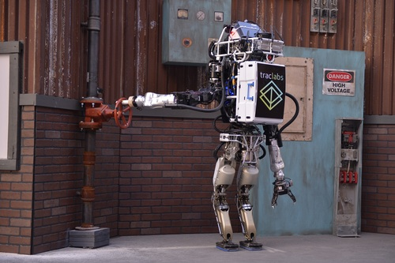
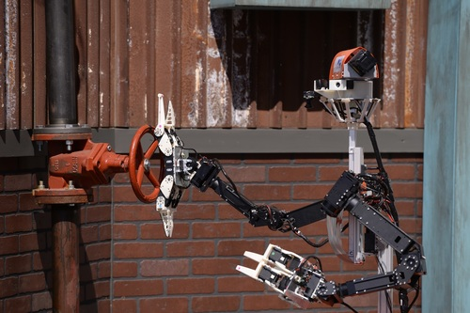
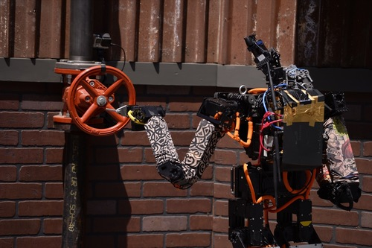
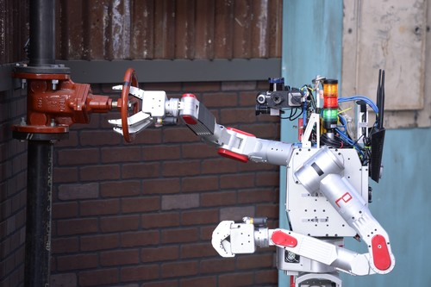
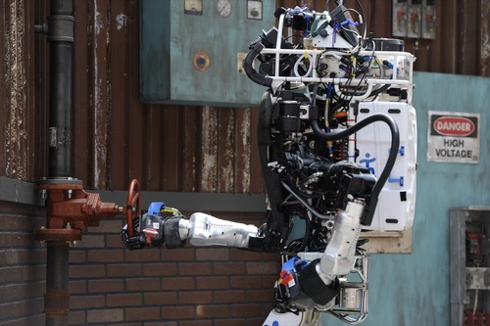
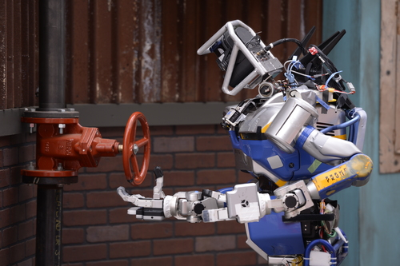
Valve Turning Task
Task: make a full valve turn
Strategy: stabilize base link, use only one end-effector
Contact strategy depending on end-effector shape

Slide 3
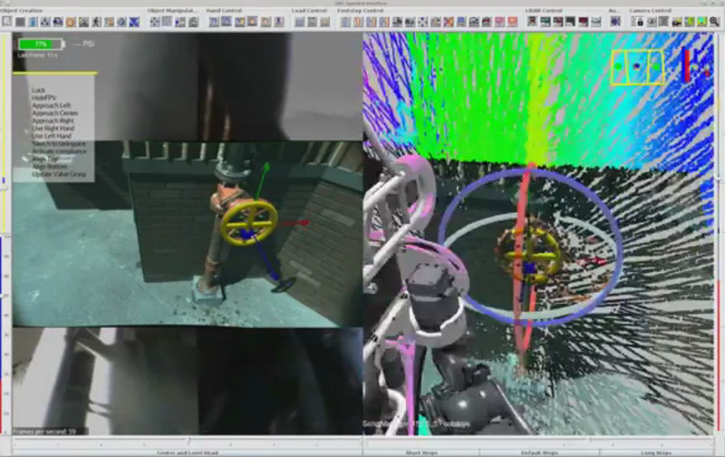
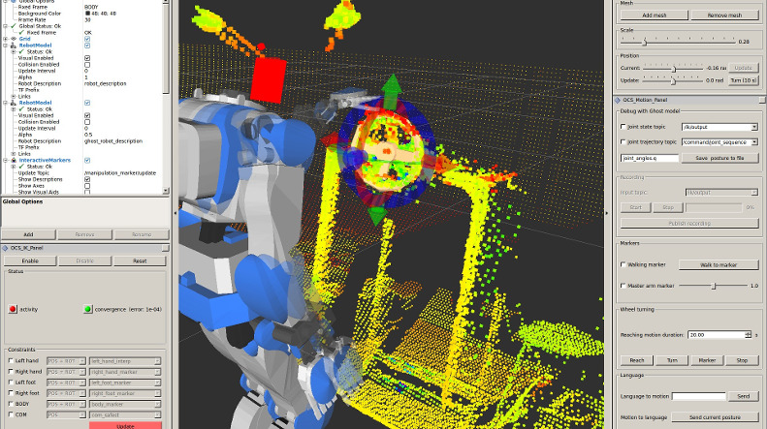
Challenges
GUI from Team IHMC
Degraded Communications
Perception:
  Environment
  Valve position and orientation
  Contact locations
Execution:
  Walking and COM stabilization
  Reaching for the valve
  Turning the valve (contact)
Proposed GUI

Slide 4
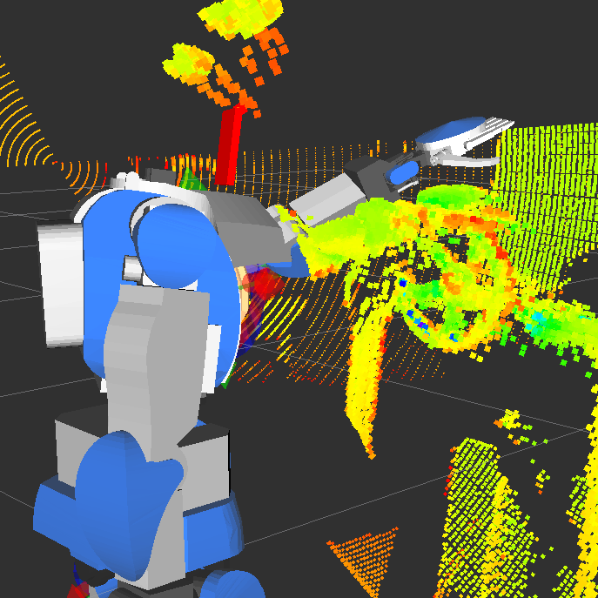
Environment model
Devices:
  Sensor: Hokuyo UTM-X002S
  Neck pitch: Dynamixel MX-64
Calibration:
  Offline on test set
  Online by human operator

Slide 5
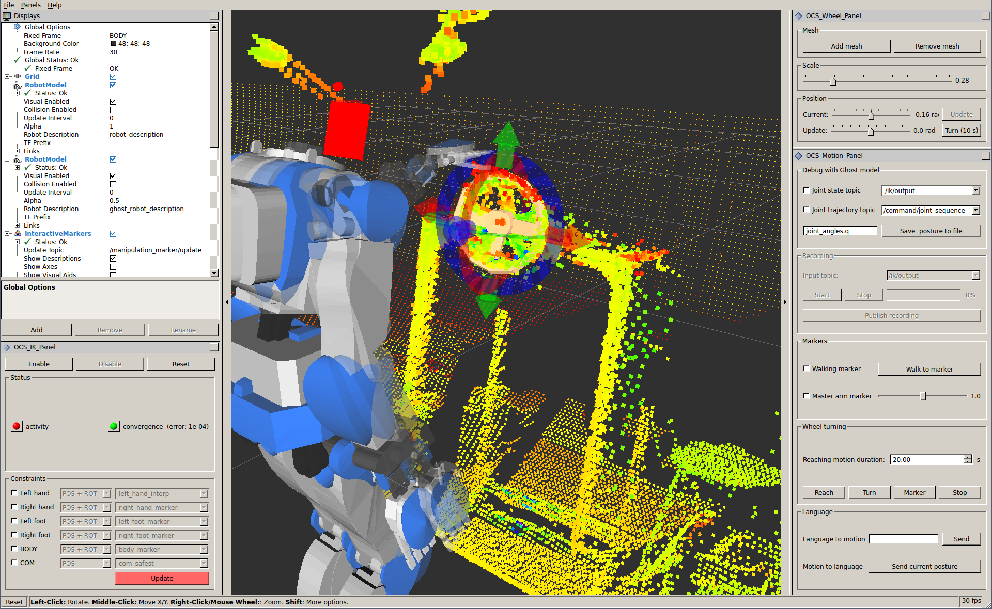
GUI
Rviz displays
IK panel: RoKi
Robot Kinetics library,
Motor Intelligence Lab,
Osaka University. http://www.mi.ams.eng.osaka-u.ac.jp/software/roki.html
Wheel panel:
  Mesh shape
  Yaw control
Motion panel:
  Ghost robot model
  Motion record/playback
  Walking Pattern Generator
  Motions: reach, turn

Slide 6
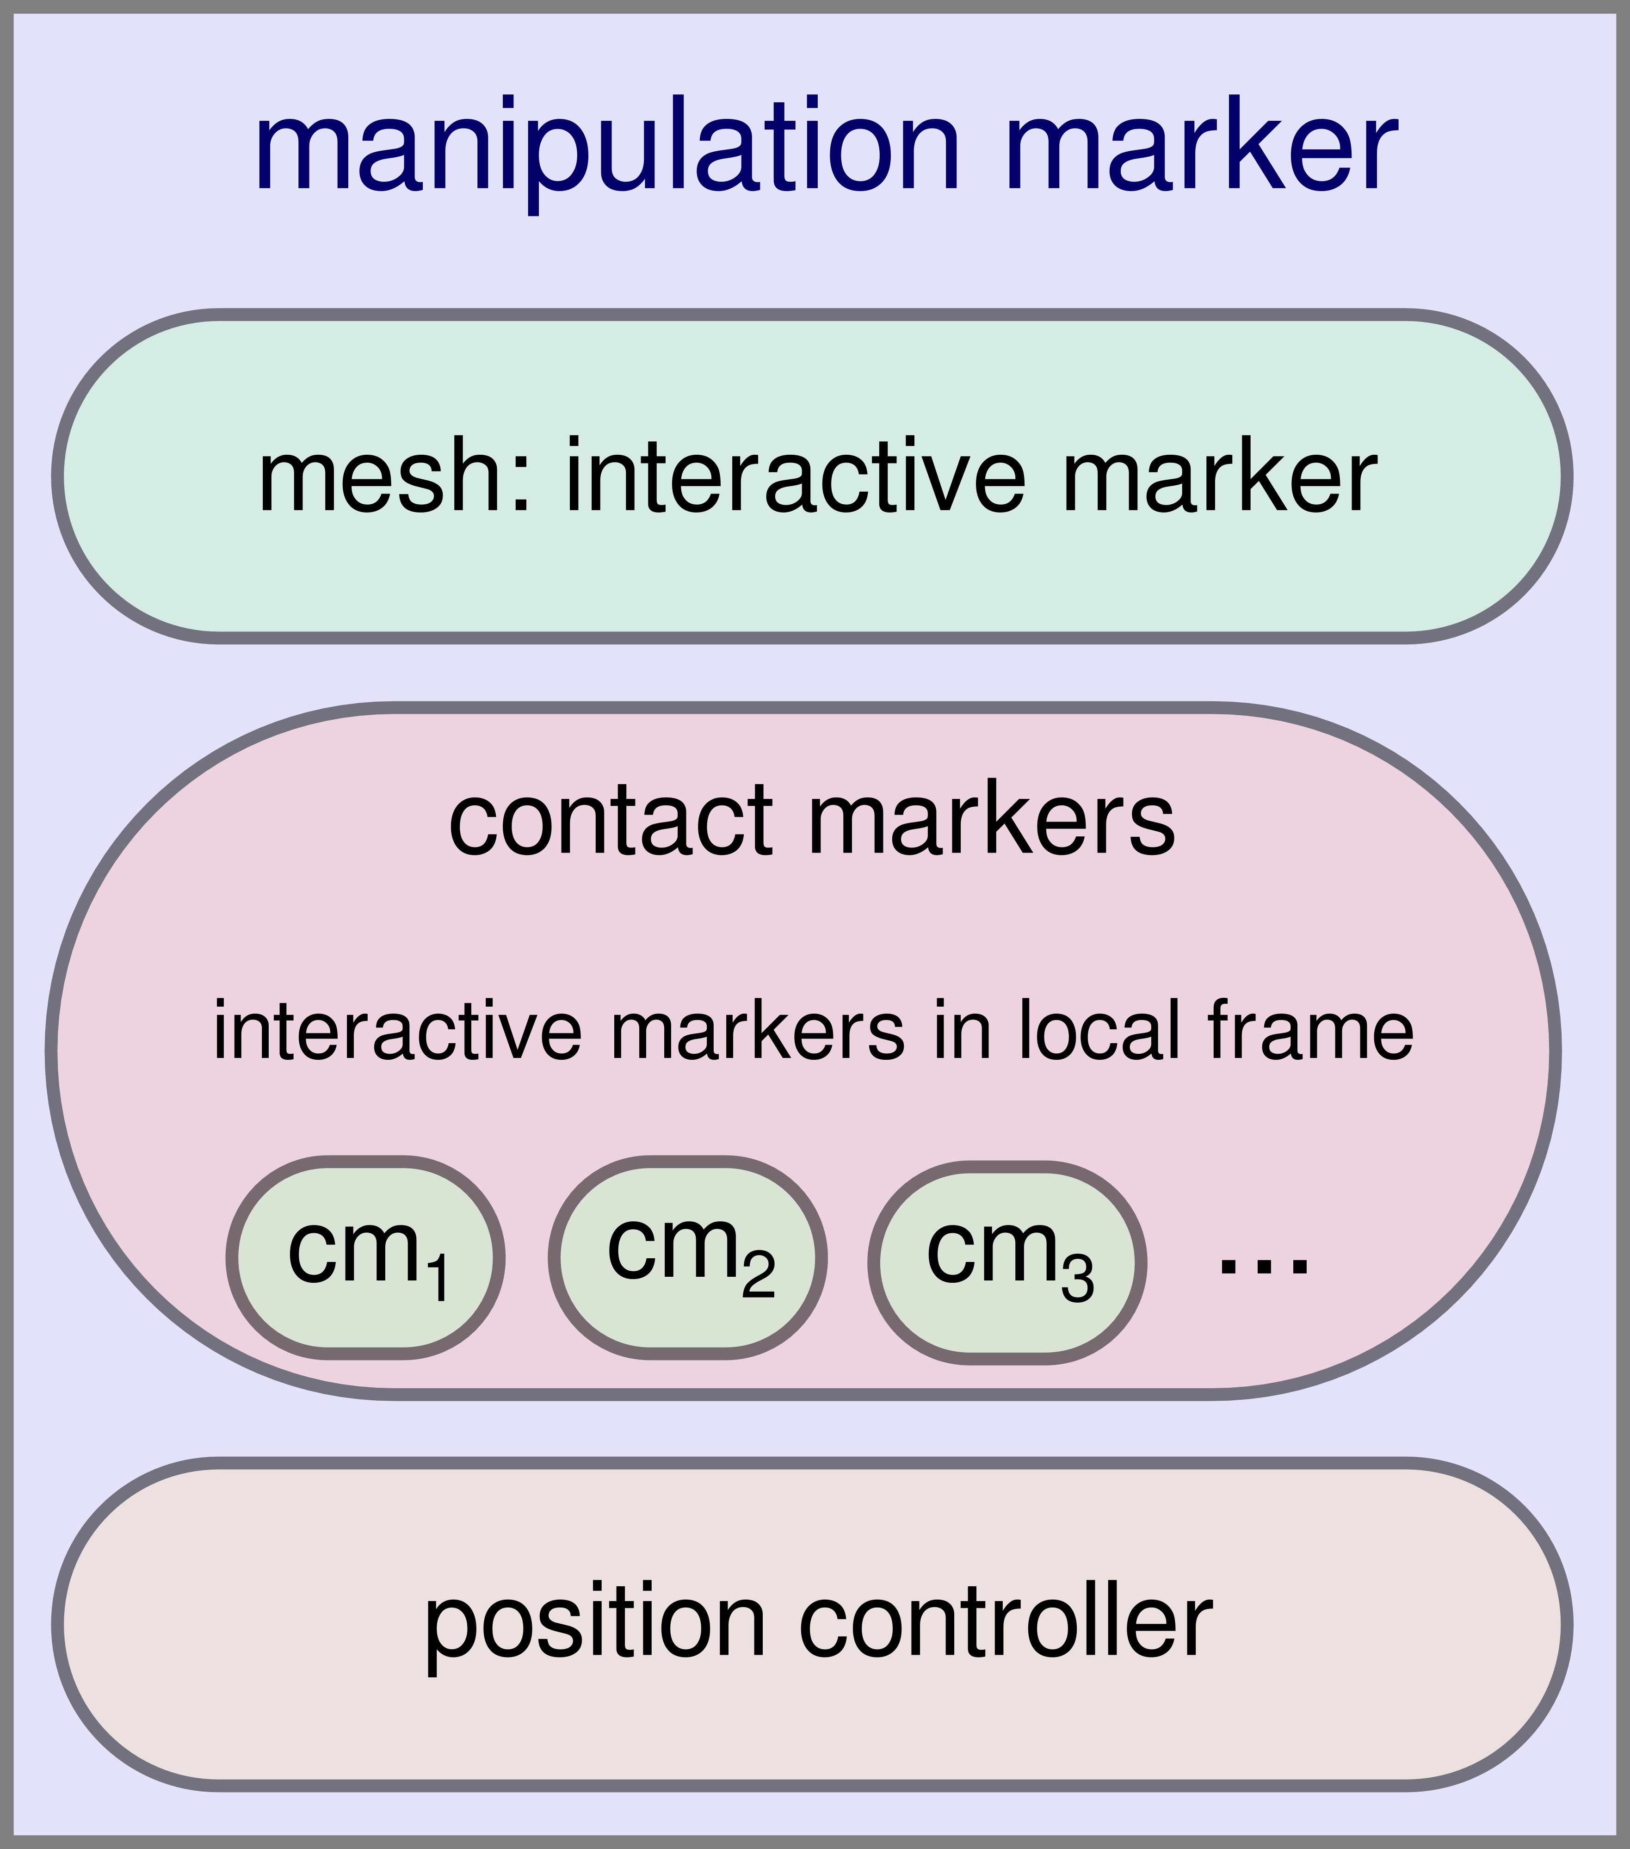
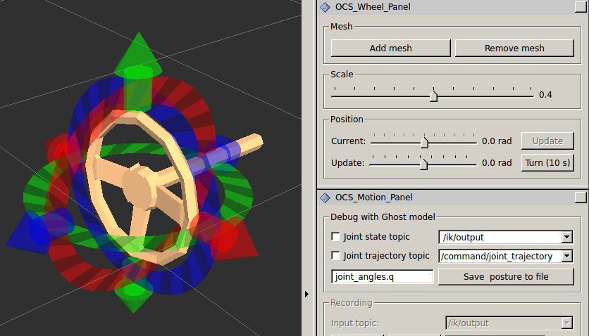
Manipulation markers

Slide 7
Valve identification

Slide 8
Reaching and turning
Reaching:
Position: cubic splines
Orientation: Spherical linear interpolation
Preview on Ghost model
Turning:
Rotate wheel mesh with constant velocity
Servoing by IK on contact marker
No preview: direct execution

Slide 9
Empirical validation

Slide 10
Conclusion
Teleoperation GUI integrated on top of Rviz
manipulation_markers*:
  Fitting of valve model on the fly
  Contact markers in local frames
Real-time joint-angle control
  Servoing using IK and markers
* Source code and more on paper page:
https://scaron.info/research/rsj-2015.html

Slide 11
Credits
Kiyoshi Irie (Chiba University of Technology)
  Point-cloud acquisition & calibration
Yasuhiro Ishiguro (Universify of Tokyo)
  ROS-RTM bridge
  RoKi & components integration
Tianwei Zhang (University of Tokyo)
  Point-cloud integration

