Slide 1
Completeness of Randomized Kinodynamic Planners with State-based Steering
Stéphane Caron^{中}, Quang-Cuong Pham^{光}, Yoshihiko Nakamura^{中}
^{中} Nakamura-Takano Laboratory, The University of Tokyo, Japan
^{光} School of Mechanical and Aerospace Engineering, Nanyang Technological University, Singapore

Slide 2
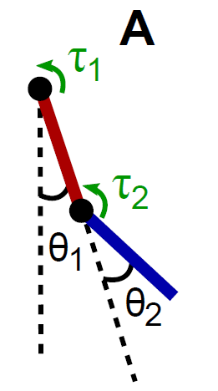
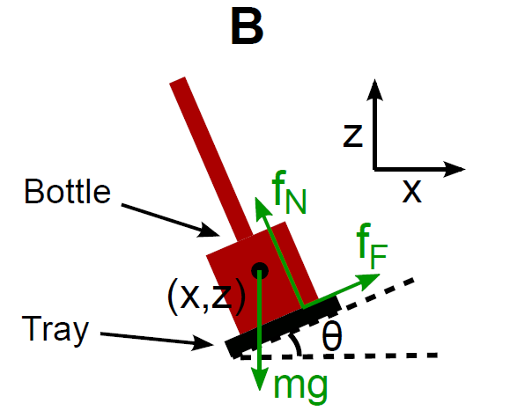
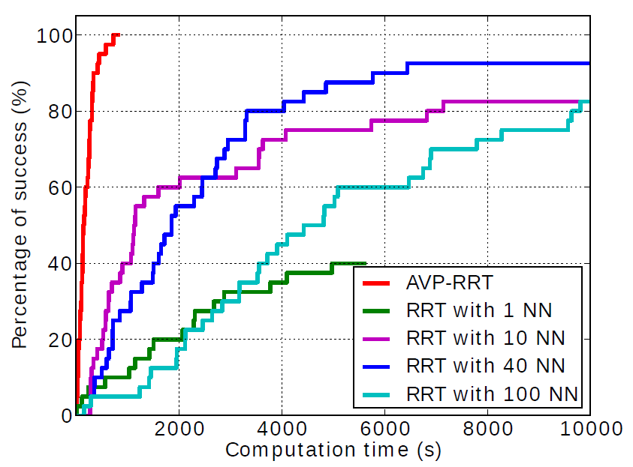
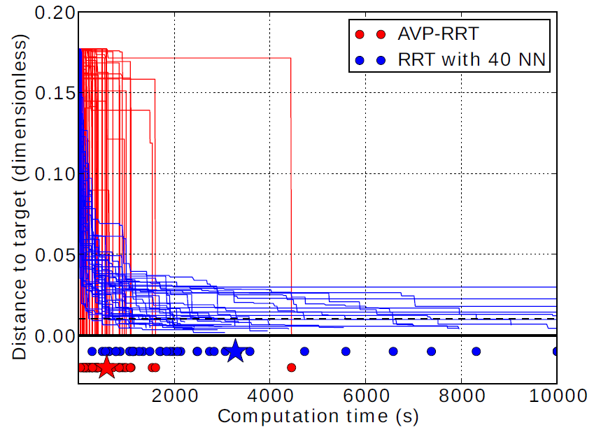
Motivation: VIP-RRT Benchmark
“Kinodynamic Motion Planners based on Velocity Interval Propagation” (RSS 2013)
Benchmark of Kinodynamic Planners
Observations: completeness?
Literature: did not help…

Slide 3
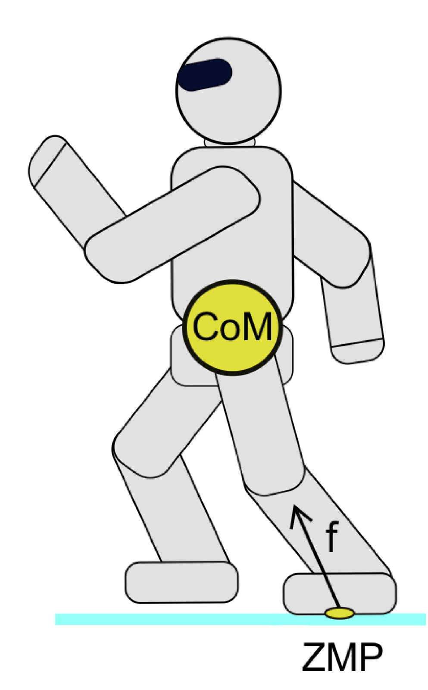
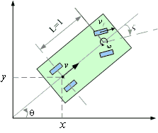
Theorem
The motion planning problem is to find a smooth trajectory connecting states $x_{init}$ and $x_{goal}$.
Consider a kinodynamic system $S$ satisfying our Assumptions 1-3, and a randomized motion planner $K$ with state-based steering satisfying our Assumptions 4-6.
If there is a solution to the motion planning problem with $δ$-clearance in control space, then $K$ will, with probability one, find such a solution after a finite number of iterations.
$K$is thus probabilistically complete.

Slide 4
Completeness
?
Completeness: if there are solutions, return one, otherwise fail
Probabilistic Completeness: if there are solutions, find one with probability one as the number of iterations goes to infinity
Why proving completeness?

Slide 5
Kinodynamic Constraints
Geometric
Dynamic Constraints
Non-Holonomic Equations
Geometric:
Holonomic equations (=)
Self-collisions ($≤$)
Obstacle avoidance ($≤$)
Non-holonomic equations:
Rolling without slipping
Conservation of angular momentum
Dynamic constraints:
Equations of motion (=)
Torque limits ($≤$)
Frictional contact ($≤$)
ZMP balance ($≤$)

Slide 6
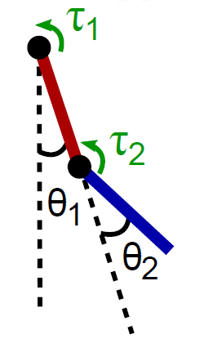
Three Examples
Pendulum with torque limits
Geometric: self-collisions
Non-holonomic: not when fully actuated
Dynamic: EoM, torque limits
Reeds-Shepp car
Geometric: obstacles
Non-holonomic: rolling without slipping
Dynamic: none
Humanoid
Geometric: foot contact, self-collisions, obstacles
Non-holonomic: not while surface foot contact
Dynamic: EoM, torque limits, frictional contact, ZMP balance

Slide 7
Randomized Motion Planner (RRT, PRM, …)
1) SAMPLE
State Space
2) PARENTS
3) STEER
Obstacle
&c.
Start

Slide 8
Steering
$$\dot{x}=f(x, u)$$
Control-based steering
Interpolate in Control Space
Use Forward Dynamics
Control Space ($u$)
State-based steering
Interpolate in State Space
Use Inverse Dynamics
$$u(t)$$
Analytical steering
Exact control-state trajectories are known between pairs of states
$$t$$
$$f^{−1}$$
$$f$$
$x$’
$$x$$
State Space ($x$)

Slide 9
Comparison of Steering Approaches
Steering | Relies on | + | -
Control-based | Forward Dynamics | Valid Controls Non-holonomy | State Constraints
State-based | Inverse Dynamics | State Constraints | Valid Controls? Non-holonomy
Analytical | Researchers’ Brains | All constraints | Hard to find!

Slide 10
This paper is about…
Kinodynamic Constraints
Steering
Geometric
Dynamic Constraints
Non-Holonomic Equations
Steering | Relies on | + | -
Control-based | Forward Dynamics | Valid Controls Non-holonomy | State Constraints
State-based | Inverse Dynamics | State Constraints | Valid Controls? Non-holonomy
Analytical | Researchers’ Brains | All constraints | Hard to find!

Slide 11
Theorem again
The motion planning problem is to find a smooth trajectory connecting states $x_{init}$ and $x_{goal}$.
Consider a kinodynamic system $S$ satisfying our Assumptions 1-3, and a randomized motion planner $K$ with state-based steering satisfying our Assumptions 4-6.
If there is a solution to the motion planning problem with $δ$-clearance in control space, then $K$ will, with probability one, find such a solution after a finite number of iterations.
$K$is thus probabilistically complete.

Slide 12
Keywording
State-based Steering
=
Trajectory Interpolation
+
Inverse Dynamics
Assumptions 4-6
Assumptions 1-3

Slide 13
Inverse Dynamics Assumptions
System
Pendulum Example
$$\dot{x}=f(x, u)$$
$$u=f^{−1}\left(x, \dot{x}\right)$$
The system is fully actuated
The set of admissible controls is compact
The Inverse Dynamics function $f^{−1}$ is Lipschitz in both arguments
Pendulum with torque limits:
$$M\left(q\right) \ddot{q}+\dot{q}C\left(q\right)\dot{q}+g\left(q\right)=u$$
Controls:
$$U_{adm}=\left\{u∈U \right| \left|u\right|≤τ_{max}\}$$
Smooth Inverse Dynamics
$$q_{2}$$
$$q_{1}$$

Slide 14
Interpolation Assumptions
Interpolation
State Space
Interpolated trajectories are smooth Lipschitz functions in both position and velocity
$$x= \left(\begin{matrix}q \\ \dot{q}\end{matrix}\right) and Δx=\left(\begin{matrix}Δq \\ Δ\dot{q}\end{matrix}\right)$$
$x$’
$$d$$
Interpolation: Smooth & Local
Interpolated trajectories stay within a neighborhood of their start and goal positions
$$η⋅d$$
$$x$$
Acceleration of interpolated trajectories converges to the discrete velocity derivative
$\left\|{\ddot{q}}_{interp} − \frac{\left\|\dot{q}\right\| Δ\dot{q}}{\left\|Δq\right\|}\right\| \overset{→}{Δx→0}$ 0
Informal alert!

Slide 15
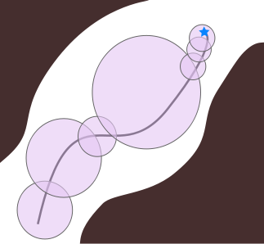
Theorem & Proof Sketch
The motion planning problem is to find a smooth trajectory connecting states $x_{init}$ and $x_{goal}$.
Consider a kinodynamic system $S$ satisfying our Assumptions 1-3, and a randomized motion planner $K$ with state-based steering satisfying our Assumptions 4-6.
If there is a solution to the motion planning problem with $δ$-clearance in control space, then $K$ will, with probability one, find such a solution after a finite number of iterations.
$K$is thus probabilistically complete.
Proof outline:
Bound controls from Eq. of Motion
Decompose into distance and acceleration terms (Lipschitz, Assumptions 5 & 6)
Build an attraction sequence
Conclude as in [LaValle et al. (2001)]

Slide 16
On a concluding note
We proved probabilistic completeness for all planners using:
State-based steering (trajectory interpolation + inverse dynamics)
Compact control constraints
System assumptions: “you can do Inverse Dynamics”
Interpolation assumptions: “be smooth & local”

Slide 17
Thank you for your attention.

Slide 18
Extra Slides Section
Venture there at your own risk!

Slide 19
Back to the VIP-RRT Benchmark
Acceleration-abusive
Interpolation

Slide 20
Assumptions you can check?
Kinodynamic planning:
Hsu et al. (1997) $(α, β)$-expansiveness with $α>0$ and $β>0$
LaValle et al. (2001) existence of an attraction sequence
Karaman et al. (2011, 2013) optimal local planner ⁽²⁰¹¹⁾ or computability of “w-weighted boxes” ⁽²⁰¹³⁾
Check?
Half-way
Strong

